Slide 1
Interdependent Sampling & Social Influence
A framework for understanding indirect attitude alignment
Based on Denrell & Le Mens (2007) • UCLA Social Network Analysis

Slide 2
The Core Puzzle
Why do socially proximate individuals consistently develop similar attitudes and preferences, even in randomly assigned settings?

Slide 3





Traditional Explanations
Accuracy Motive
Normative Motive
Identity Motive
Individuals believe that others have access to more or better information. Agreeing with the group is a heuristic for forming an accurate perception of reality.
Individuals shift attitudes to align with valued reference groups to ensure a favorable evaluation of the self and strengthen in-group identification.
Individuals comply to ensure satisfactory relationships. Expressing deviant opinions may lead to social sanctions, motivating conformity to get along.

Slide 4

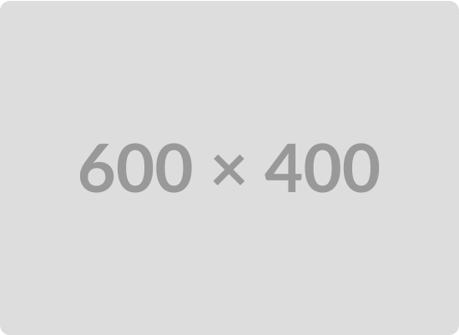
A New Perspective
Indirect Influence via Behavior
•
Existing theories focus on why A changes their mind when learning B's attitude.
•
Denrell & Le Mens propose an indirect effect: B's attitude dictates what A experiences.
•
If B enjoys a restaurant, A joins B there. A's evaluation is entirely independent, but A is exposed to the restaurant solely because of B.
•
Friends don't change how you evaluate things; they change what you evaluate.

Slide 5
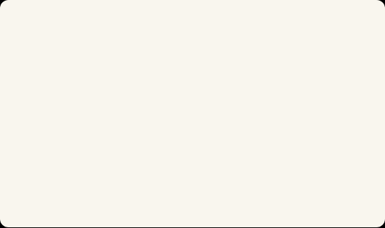
The Learning Model
Independent Experiences
Attitude Formation
Whenever individuals sample an event, their experiences are independent random variables. They may have different tastes. If A and B go to a movie, A might love it while B hates it. Their attitudes do not converge merely because experiences are identical.
Attitudes are modeled as an exponentially weighted average of past experiences. The current attitude is adjusted up or down based solely on personal evaluations of new experiences. Direct persuasion from peers is strictly absent from the model.

Slide 6

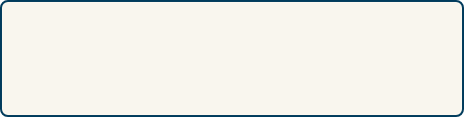

Joint Sampling Decision
Individual Choice
Interdependent Sampling
Left alone, an individual's desire to sample depends on their current attitude. Positive attitudes lead to approach; negative lead to avoidance. This is modeled using the exponential Luce choice model:
In social relationships, decisions are often joint. The probability that A samples an activity is an increasing function of B's attitude. Even if A does not want to sample (due to a negative attitude), A might still do so if B wants to. This reciprocity alters A's exposure.

Slide 7
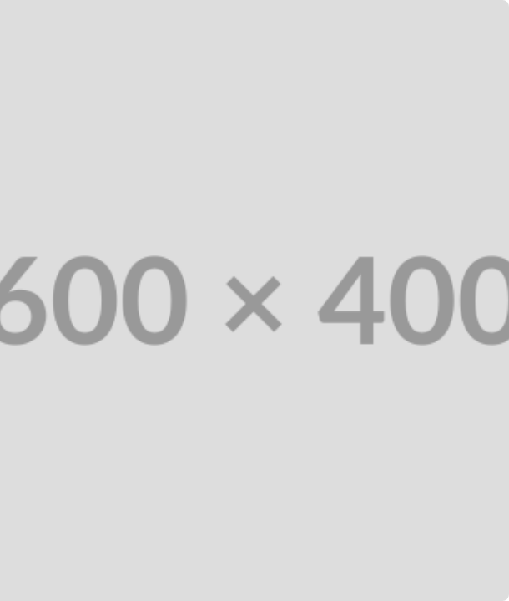
Overcoming Negativity
Independent learners suffer from a negativity bias: false negative beliefs persist because individuals avoid the object and never correct their view.
Interdependent sampling forces re-evaluation. If B has a positive attitude, A is dragged along to sample again. This exposure gives A the chance to experience a positive outcome and update their false negative attitude.

Slide 8
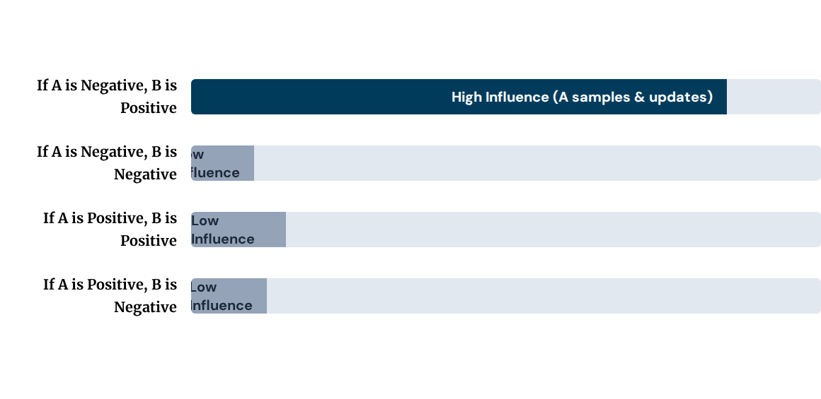
Asymmetric Influence
The model predicts that A is heavily influenced by B when A's attitude is negative, but barely influenced when A's attitude is positive.
When A is positive, A samples anyway, so B's attitude matters little. When A is negative, A only samples if B pushes them, making B's attitude the critical variable for A's attitude change.

Slide 9
Empirical Evidence
Newcomb's Fraternity Data (1961)
•
Students assessed their "favorableness" toward peers over 16 weeks.
•
Regression analysis confirms the asymmetry: Student A's attitude toward Student C is significantly more influenced by Student B if A initially dislikes C.
•
Sacerdote (2001) found similar effects with Dartmouth roommates: students with the lowest academic backgrounds were most influenced by their peers.

Slide 10





Network Implications
Transitivity
Reciprocity
Power & Attraction
If A likes B, and B likes C, A is more likely to be exposed to C (through B's sampling). This repeated exposure naturally fosters a positive attitude toward C.
If A likes B, A initiates contact. Even if B initially holds a negative impression, repeated exposure through A's approach allows B to update their impression positively.
Powerful or attractive individuals dictate sampling. You join their activities because of who they are, inadvertently exposing yourself to their preferences and adopting them.

Slide 11
Conclusion
Social influence does not strictly require a psychological desire to conform. A simple desire to share activities and time together is mathematically sufficient to drive attitude alignment across social networks.

Slide 12
Questions?
Thank you for your attention.
UCLA Advanced Social Network Analysis

